Slide 1
KeyStone Bootloader
KeyStone Training
Multicore Applications
Literature Number: SPRP805

Slide 2
Agenda
Boot Overview
Boot Modes
File Formats
Boot Mode Details
Second Stage Boot

Slide 3
Boot Overview
KeyStone Bootloader

Slide 4
Gel Routine at Connect
Global_Default_Setup_Silent()
{
Set_DSP_Cache();
if (DNUM == 0)
{
status = Init_PLL(PLL1_M, PLL1_D);
// Setup all Power Domains on
Set_Psc_All_On( );
}
// Setup Pll3 pass clk @ 1050 MHz
Init_Pll3(PLLM_PASS, PLLD_PASS);
// Setup Pll2 DDR3 PLL @ 667 MHz
Init_Pll2(PLLM_DDR, PLLD_DDR);
xmc_setup();
ddr3_setup_auto_lvl_1333(0);
}
// Configure SGMII SERDES
configSGMIISerdes();
EnableEDC_OneforAll();
GEL_TextOut( "Configuring CPSW ...\n");
setCpSwConfig();
}

Slide 5
Gel Routine During Load
OnFileLoaded(int nErrorCode, int bSymbolsOnly)
{
// Allows only core 0 can do i2c programming
if (DNUM == 0)
{
// Checks if eeprom i2c programming was started
if (i2cprog!=0)
{
// Test for little endian
if (i2cprog==LITTLE_END)
{
// For little endian
// Remove i2c eeprom switch
i2cprog=0;
// Load data file to program
GEL_MemoryLoad(0x900000, 0, 0x10000, "$(GEL_file_dir)\\dsprom.dat");
// Load i2c programmer parameters file
GEL_MemoryLoad(0x800000, 0, 0x60, "$(GEL_file_dir)\\..\\i2crom\\params_le.dat");
// Programs the dsp eeprom
GEL_Run();
}

Slide 6
Generic Boot Procedure

Slide 7
ROM Boot Loader (RBL): Definition
ROM Boot Loader (RBL):
Software code used for device startup.
Transfers application code from memory or host to high-speed internal memory or DDR3.
Burned in ROM (non-modifiable) during manufacture
Base address of 0x20B00000 (DSP), 0x00000000 (ARM)
C66x CorePac
RBL can be executed by either the C66x core or the ARM core. The boot behavior varies depending on the core type that initiates the boot process.
ROM
ARM CorePac

Slide 8
Boot Process Requirements
Select booting method:
Which CPU (ARM 0 or DSP Core 0) manages the boot
All other cores are in idle state, waiting for interrupt
Which boot mode to use
Update the configuration
Trigger to use the configuration to prepare for booting
Configuring the device (PLLs and more)
Load the image of the executable into the device
Trigger all cores to run the executable

Slide 9
KeyStone PLL Settings
PLL settings are user-configured to ensure proper operation of the selected device
The KeyStone Data Manual for each device includes one or more PLL tables:
System PLL settings configure the system clock.
ARM PLL settings configure the ARM clock speed.
PA PLL settings configure PA (Packet Accelerator) clock.

Slide 10
Example of PLL Configuration
The boot code sets the PLL multiplier based on the core frequency set in the EFUSE register.
PLL Clock Configuration for KeyStone Devices
Boot PLL Select [2:0] | Input Clock Freq (MHz) | Core = 800 MHz |  | Core = 1000 MHz |  | Core = 1200 MHz |  | Core = 1400 MHz
 |  | Clkr | Clkf | Clkr | Clkf | Clkr | Clkf | Clkr | Clkf
0 | 50.00 | 0 | 31 | 0 | 39 | 0 | 47 | 0 | 55
1 | 66.67 | 0 | 23 | 0 | 29 | 0 | 35 | 0 | 41
2 | 80.00 | 0 | 19 | 0 | 24 | 0 | 29 | 0 | 34
3 | 100.00 | 0 | 15 | 0 | 19 | 0 | 23 | 0 | 27
4 | 156.25 | 24 | 255 | 4 | 63 | 24 | 383 | 24 | 447
5 | 250.00 | 4 | 31 | 0 | 7 | 4 | 47 | 4 | 55
6 | 312.50 | 24 | 127 | 4 | 31 | 24 | 191 | 24 | 223
7 | 122.88 | 47 | 624 | 28 | 471 | 31 | 624 | 13 | 318
PLL Clock O/P = (Input Clock x (Clkf + 1))/(2 * (Clkr + 1))

Slide 11
RBL Flow
Diagram
Boot Start
No
POR or RESETFULL?
Yes
Check the PWRSTATECTL Register for hibernation
Latch the boot mode from the Boot Strap Pins
(DEVSTAT)
No
Boot Parameter Table init
Hibernation?
Yes
Initialize the PLLs –
The PLL setting from DEVSTAT
PLL required?
Yes
Branch to the address provided by the PWRSTATECTL
No
PLL is bypassed
Branch to function depending on the boot mode
Boot mode specific process

Slide 12
Boot Modes
KeyStone Bootloader

Slide 13
KeyStone Boot Mode Categories
Various boot modes are supported on KeyStone devices.
Boot modes are broadly divided into three categories:
Memory boot, where the application code is stored in a slow external memory and DSP acts as a master and drives the boot process
Host boot, where host that can write directly to memory and has knowledge of the boot device memory map
Host boot, where host is unaware of the memory structure of the boot device and CPU moves the data into memory

Slide 14
KeyStone Boot Modes
Master Mode: CPU manages the boot process
Either DSP Core 0 or ARM A15 Core 0
CPU configures peripheral and reads the boot information
Examples: I2C master mode, SPI boot, EMIF 16 boot
Slave Mode Direct IO: CPU needs to configure a peripheral
External master configures the other registers and loads the code
Examples: HyperLink boot, PCIe boot, SRIO Direct IO boot
Slave Mode Messaging: CPU configures a peripheral and manages the protocol
Ethernet-based, where CPU manages the packets
SRIO packet-based, where CPU configures the SRIO master and then the SRIO manages the download

Slide 15
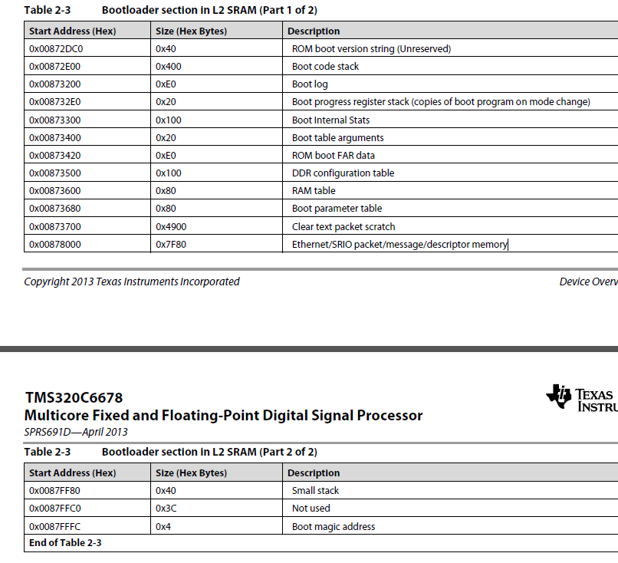
Boot Process Memory Usage
DSP boot uses part of L2 for the boot process
Address depends on the device; For C6678, address starts at 0x0087 2DC0

Slide 16
Magic Address
Do not put code or initialized memory in these locations
NOTE: This address is usually where L2 cache is located.
Magic Address: The address where the core goes after the boot process begins (from idle, after it gets an interrupt)
The last 4 bytes of L2; For C6678, it is 0x0087 FFFC (local)
The boot process must enter the start address for the Magic Address location before generating interrupt for all the cores
Obviously, the boot process uses the global magic address location (of all other cores)
What about ARM boot?
Similar tables are used by the ARM and are located in MSMC memory
Different magic address for different boot (more on this later).

Slide 17
KeyStone I Boot Configuration Pins
Boot mode and configurations are chosen using bootstrap pins on the device.
Pins are latched and stored in 13 bits of the DEVSTAT register during POR (Power On Reset).
The configuration format for these 13 bits are shown in the table:
Boot Device [2:0] is dedicated for selecting the boot mode
Device Configuration [9:3] is used to specify the boot mode specific configurations.
PLL Multi [12:10] are used for PLL selection. In case of I2C/SPI boot mode, it is used for extended device configuration. (PLL is bypassed for these two boot modes)
Boot Mode Pins
12 | 11 | 10 | 9 | 8 | 7 | 6 | 5 | 4 | 3 | 2 | 1 | 0
PLL Mult I2C/SPI Ext Dev Cfg |  |  | Device Configuration |  |  |  |  |  |  | Boot Device

Slide 18
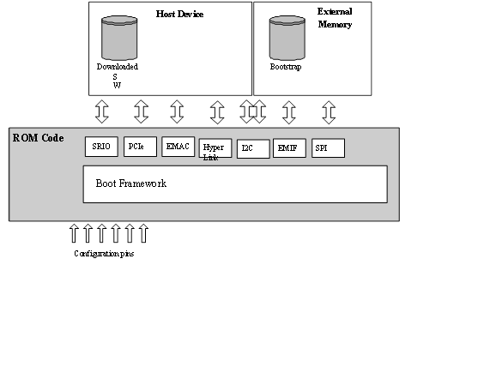
KeyStone I ROM Boot Modes
To identify the boot modes available for your device, refer to the data manual.
I2C Boot
Master Boot (from I2C EEPROM)
Master-Broadcast Boot(Master Boot followed by broadcast to slave cores)
Passive Boot (external I2C host)
SPI Boot (from SPI flash)
SRIO Boot (from external host connected through SRIO)
Ethernet Boot (boot from external host connected through Ethernet)
PCIe Boot (boot from external host connected through PCIe )
HyperLink Boot (boot from external host connected through HyperLink)
EMIF16 NOR Boot (boot from NOR Flash)
EMIF16 NAND Boot (boot from NAND Flash)

Slide 19
KeyStone I Boot Device
Boot Device Selection Values
For interfaces supporting more than one mode of operation, the configuration bits are used to establish the necessary settings.
Boot Mode Pins: Boot Device Values
Value | Boot Device
0 | Sleep(6670) / EMIF16¹
1 | Serial Rapid I/O
2 | Ethernet (SGMII) (PA driven from core clk)
3 | Ethernet (SGMII) (PA driver from PA clk)
4 | PCIe
5 | I2C
6 | SPI
7 | HyperLink
1. See the device-specific data manual for information.

Slide 20
KeyStone II Boot Modes
KeyStone II device boot methods:
Sleep boot
I2C master boot
SPI boot
NAND boot
XIP boot
UART boot
Ethernet boot
SRIO boot
HyperLink boot
PCIe boot
ARM Master boot
The various boot modes available depend on the device used. To select the boot mode for your device, refer to the data manual for the different options available.

Slide 21
KeyStone II Boot Strap Selection
DEVSTAT Boot Mode Pins ROM Mapping
16 | 15 |  | 14 |  | 13 |  | 12 | 11 | 10 | 9 | 8 | 7 | 6 |  | 5 | 4 | 3 | 2 | 1 | Mode
X | X |  | 0 |  | Arm en |  | Sys en | ARM PLL Cfg |  |  | Boot Master | Sys PLL Cfg |  |  |  | min | 0 | 0 | 0 | Sleep
Slave Addr |  |  | 1 |  | Port |  |  | ARM PLL Cfg |  |  |  |  |  |  |  |  | 0 | 0 | 0 | I2C Slave
X | X |  | X |  | Bus Address |  |  | Param Idx / Offset |  |  |  | X |  | Port |  |  | 0 | 0 | 1 | I2C Master
width | csel |  |  |  | mode |  |  |  |  |  |  | Npin |  |  |  |  | 0 | 1 | 0 | SPI
0 | base |  |  |  | wait |  | width | ARM PLL Cfg |  |  |  | Sys PLL Cfg |  |  |  | 0 | 0 | 1 | 1 | XIP (ARM Master)
 |  |  |  |  |  |  |  | X | Chip sel |  |  |  |  |  |  |  |  |  |  | XIP (GEM Master)
1 | First Block |  |  |  |  |  | Clear | ARM PLL Cfg |  |  |  |  |  |  |  | min |  |  |  | NAND (ARM Master)
 |  |  |  |  |  |  |  | X | Chip Sel |  |  |  |  |  |  |  |  |  |  | NAND (GEM Master)
lane | Ref Clock |  |  | Data Rate |  |  |  | ARM PLL Cfg |  |  |  |  |  |  |  |  | 1 | 0 | 0 | SRIO (ARM Master)
X |  |  |  |  |  |  |  | Lane Setup |  |  |  |  |  |  |  |  |  |  |  | SRIO (GEM Master)
Pa clk | Ref Clk |  |  | Ext Con |  |  |  | ARM PLL |  |  |  |  |  |  |  |  | 1 | 0 | 1 | Ethernet (ARM Master)
 |  |  |  |  |  |  |  | rsvd | Lane Setup |  |  |  |  |  |  |  |  |  |  | Ethernet (GEM Master)
Ref clk | Bar Config |  |  |  |  |  |  | ARM PLL |  |  |  |  |  |  |  | 0 | 1 | 1 | 0 | PCIe (ARM Master)
 |  |  |  |  |  |  |  | SerDes Cfg |  |  |  |  |  |  |  |  |  |  |  | PCIe (GEM Master)
Port | Ref Clk |  |  | Data Rate |  |  |  | ARM PLL |  |  |  |  |  |  |  | 1 | 1 | 1 | 0 | Hyperlink (ARM Master)
 |  |  |  |  |  |  |  | SerDes Cfg |  |  |  |  |  |  |  |  |  |  |  | Hyperlink (GEM Master)
X | X | X |  | X |  | Port |  | ARM PLL |  |  |  | Sys PLL Cfg |  |  |  | min | 1 | 1 | 1 | UART (ARM Master)
X | X | X |  | X |  |  |  | X | X | X |  |  |  |  |  |  |  |  |  | UART (GEM Master)

Slide 22
BOOT Process Triggers
Triggers are mechanisms that initiate the execution of the RBL. KeyStone devices use resets as triggers.
Four types of resets:
Power on Reset (PoR)
Reset Full
Reset
Local Reset

Slide 23
Reset Types
Power on Reset (POR) (Cold Reboot)
Resets everything
Latches the boot strap pins
RBL Process initiated
RESETFULL (Warm Reboot)
Resets everything
Latches the boot strap pins
RBL Process initiated
RESET (Can be configured as hard or soft)
Resets everything except EMU and reset isolated peripherals.
No latching of the boot strap pins.
For software reset PCIe, EMIF16, DDR3 and EMIF MMRs are also preserved.
RBL process is initiated.
LRESET
Mostly used by watch dog timer
Just the CorePac is reset all the memory are preserved.
No RBL process is initiated.

Slide 24
File Formats
KeyStone Bootloader

Slide 25
KeyStone I Boot Formats
Boot Parameter Table is used for configuration and is part of the boot process table. It contains two parts:
Common set of parameters for system configuration
Unique parameter settings for each boot method
Master boot modes expect two tables:
Boot Table contains code that needs to be loaded into the device.
Boot Configuration Table is a register configuration table that is used to manipulate memory map registers.

Slide 26
Boot Parameter Format
Boot Parameter Table:
Provides a “map” for the boot process
The boot process copies a default Boot Parameter Table into reserved L2 of Core 0.
The first 10 bytes of the Boot Parameter Table are common across all the boot modes:
Length
Checksum
Boot Mode
Port Num
PLL configuration (most significant bits)
PLL configuration (least significant bits)
The rest of the Boot Parameter Table is boot-mode dependent.

Slide 27
Boot Parameter Table Setup
0x00000000
or
0x20B00000
The RBL contains a default boot parameter table for each boot mode (shown in the middle of the RBL Code section to the right).
After POR or RESETFULL, the RBL checks the DEVSTAT register for the boot mode selected (For example, SPI).
The RBL then copies the default SPI Boot Parameter Table to the reserved section of either L2 (DSP master boot) or MSMC (ARM master boot)
Finally, the RBL updates the copied table with any custom configurations that were passed in when the boot strap pins were latched into the DEVSTAT register.
Once the custom parameter table is stored in L2 or MSMC, the RBL uses it as a blueprint for the rest of the boot.
(The colors on the graphic are meant to show that these sections are completely separate in the device memory map)
RBL Code…
Default I2C Parameter Table
Default SRIO Parameter Table
Step 3
Default … Parameter Table
Default SPI Parameter Table
RBL Code…
Step 4
DEVSTAT Register
0x02620020
L2 or MSMC
Memory space used by RBL …
Custom SPI Parameter Table
Memory space used by RBL …
End of L2 or MSMC

Slide 28
Boot Image Format
Boot Table:
Block of data that contains code and data sections
The block is loaded from the host or external memory to the internal memory or DDR by the RBL.
The first 8 bytes of each section in the Boot Table form the section’s header:
32-bit section bytes count
32 bit section address where the block has to be moved
The end of table is identified by writing 0s.

Slide 29
Register Configuration Format
Boot Configuration Table:
Provides read/modify/write capabilities to any MMR on the device.
Each entry has three 32-bit-wide elements.
First element is the address to be modified
Second element is the set mask
Third element is the clear mask
If all three elements are 0s, this indicates the end of the Boot Configuration Table.

Slide 30
Slave Direct IO Modes
The master loads the code and sets the MMR configurations
TI provides a set of tools to help. For example, for DSP code, Hex6x:
Converts DSP .out format into hex ASCII format
Hex6x is described in TI Assembly Language Tools User’s Guide http://www.cs.cmu.edu/afs/cs/academic/class/15745-s05/www/c6xref/assembly.pdf

Slide 31
Utilities Used to Generate Different Tables
Hex6x is used to convert the application code into a boot table format.
Romparse is used to append the boot parameter to a boot table or a boot configuration table.
Bconvert6x is used to convert the boot table derived from a little endian application code to a big endian format. This is required as the RBL assumes all the images to be in big endian mode.
B2i2c is used to convert the boot table into a i2c/spi format table. This table can be loaded into an EEPROM that is connected through I2C to the device.
Bootpacket is used to break the boot table into packets that can be sent from the host to the device booted in Ethernet boot mode.
Pcsendpkt is used to help the host send the packets generated by bootpacket to the boot device.

Slide 32
KeyStone I Additional Utilities
Building the boot table:
If the EVM is set in little endian mode, convert the boot table to big endian mode (used by the RBL) using the bconvert64x utility (available in MCSDK).
Convert to an I2C format (to be loaded into the EEPROM) using the b2i2c utility (available in MCSDK).
Append the boot parameter table to the boot table using romparse (Available in MCSDK), which uses a map file to retrieve the boot parameter tables.

Slide 33
KeyStone II ARM Boot BLOB Image Formats
BLOB = Binary Large Object
Treats the executable as a data byte stream
The BLOB will cover the entire memory location used by the application
When the BLOB is received, the RBL loads it in the base of MSMC.
Future devices may use other addresses
If the code needs to be placed in other memories (For example, DDR), “self-relocating code” must be used.
BLOB format is used for PCIe boot, UART boot, Ethernet boot
Once the BLOB loading is complete, the RBL jumps the Core 0 PC to base of MSMC and starts executing.
Magic address of the ARM:
Core 0: 0x0C5A D000
Core 1: 0x0C5A D004
Core 2: 0x0C5A 0008
Core 3: 0x0C5A D00C

Slide 34
KeyStone II BLOB Generation Tools
armhex converts the .out file into an ASCII hex file.
Located in ccs_v5_4_x\ccsv5\tools\compiler\arm_X.X.X\bin
Usage of armhex is described in the ARM Assembly Language Tools User’s Guide http://www.ti.com/lit/ug/spnu118l/spnu118l.pdf
b2ccs.exe converts the ASCII hex file into a CCS .dat format.
CCS uses the .dat format to load data via the CCS memory browser
Acts as intermediate format for boot
ccs2bin.exe converts the CCS .dat format to a BLOB.

Slide 35
KeyStone II ARM GPH Formats
Similar to boot table for DSP boot but without start address; Used by EMIF NOR and NAND boot, SPI boot, I2C boot
GPH (General Purpose Header) format:
Block 0 length
Block 0 Base Address
Block 0 data
…
Block last length
Block last base address
Block last data
Termination (0 for block length)
During boot, once the end of table is reached, RBL jumps to the base address of the last block.

Slide 36
KeyStone II GPH Format Tools
armhex converts DSP .out file to ASCII hex file.
B2css converts the ASCII hex file to CCS .dat format.
ccsAddGphdr adds a general purpose header to the CCS .dat file and also updates the CCS .dat header to account for the added 8 bytes of length.
ccsAddGptlr adds a general purpose tail to the CCS .dat file and also updates the CCS .dat header to account for the added 8 bytes of length.
Catccs combines two CCS format files into a single file, for two stage boot for example

Slide 37
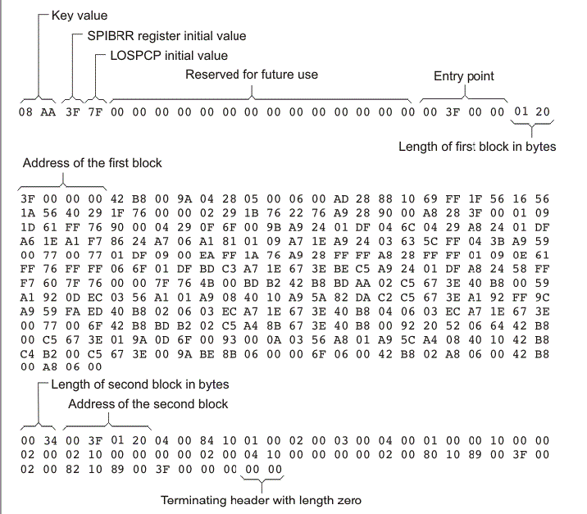
Hex Converter out for 8-bit SPI boot ARM Assembly Language Tools User’s Guide, Chapter 12

Slide 38
Boot Mode Details
KeyStone Bootloader

Slide 39
KeyStone I: I2C Master Boot
PLL is in bypass mode.
Can be used to run a work-around before running the main boot method
Can modify the boot parameter table that is used by RBL.
After running the work-around, can modify the boot parameter table to boot in another boot method.
Images are stored in the EEPROM in two pages that are divided into blocks of 0x80 bytes.

Slide 40
KeyStone I Boot Modes Summary
I2C Slave: Device configuration uses 5 bits of device configuration and the I2C address is calculated by adding 0x19 to the I2C address specified in the device configuration
SPI Boot: Same as I2C mode; instead of pages, the NOR flash is selected based on the chip select
Ethernet Boot: Configure the SERDES and NETCP if available, but not the PHY
SRIO BOOT: Supports direct IO (slave mode) and Type 11 messages (similar to Ethernet)
PCI Boot: Only End Point (DSP); Similar to SRIO direct IO; Supports legacy interrupt as well as EP interrupt
HyperLink Boot
Similar to SRIO direct IO, HyperLink interrupt is connected to DSP Core 0

Slide 41
KeyStone II Boot Loading Process: I2C Boot
PLLs are bypassed in this mode.
The application to be loaded is converted into a GP header format table and loaded in the EEPROM.
Generally, a two-stage bootloader process is carried out.
First stage loads the image that has the PLL settings and modifies the boot parameter table to point to the next address in EEPROM where the real image is loaded. Then re-enter the RBL.
In second stage, the real image is loaded.

Slide 42
KeyStone II Boot Loading Process: XIP boot
The image to be loaded is in the GP header format and loaded in the EMIF NOR flash.
Once the boot is triggered, the GP header blocks are loaded based on the base address and the byte size.
Once the last block is detected, the RBL branches ARM Core 0 to the base address specified in that block and starts executing.
See device Errata

Slide 43
KeyStone II Boot Summary
SPI Boot: PLLs are bypassed in this mode. GP format
Ethernet Boot: Does not initialize the PHY, need IP address, BLOB format to MCMS memory
SRIO Boot: GP format in messaging mode, BLOB in direct IO mode
PCI boot: BLOB format, BAR and SERDES are configured, EP mode
HyperLink Boot: BLOB format, configure interrupt to the ARM
NAND Boot: GP format, similar to I2C or SPI
UART Boot: BLOB format, uses XMODEM protocol

Slide 44
Second Stage Boot
KeyStone Bootloader

Slide 45
Second Stage Boot Load Process
Q: What if more boot parameters are needed than can be specified in the boot pins?
A: Other parameter values can be updated through the I2C boot mode.
In this case, the I2C boot starts with an I2C boot parameter table, which in turn loads a custom updated parameter table for a specific boot mode.
Once the default parameter table is updated, the boot code executes using the updated boot parameter structure, following the same process as the primary boot mode.

Slide 46
Second Stage Boot Load Specifics
The loaded EEPROM image has two boot parameter table blocks.
The first block is an I2C boot parameter table, which sets the core clock and the address of the next block.
The next block includes the requested boot mode-specific boot parameter table with user-specified values.
After loading this image, the boot mode in the boot strap is set for I2C master boot.
After POR, the I2C boot code is executed as a first-stage boot load, which updates the default boot parameter table and re-enters the boot code, executing the boot code utilizing the user-specific parameters.

Slide 47
Intermediate Boot Loader (IBL)
Originally created as a work-around for a PLL locking issue in the C667x PG1.0 version.
Same process as second stage boot loading.
Also provides additional boot features:
TFTP boot
NAND boot
NOR boot
In the EVM, the FPGA is programmed to boot IBL, execute the PLL fix, and then jump right back to RBL for the set boot mode.

Slide 48
KeyStone I Booting Multiple Cores
During the boot process, the boot loader code is loaded into the L2 of CorePac 0 from the ROM.
The high 0xD23F (52K) bytes of L2 in all CorePacs are reserved for the boot code. User should not overwrite this area.
All the other cores will execute an IDLE.
User should load the image into the L2 of CorePacs they want to boot.
Before setting the Boot Complete register, the user should also set the start address of the code in the respective Boot Magic Address of the CorePac L2.
Finally, the user image should also write the IPC Interrupt register to bring the required CorePacs out of IDLE.

Slide 49
KeyStone II Booting Multiple cores
ARM Core 0 is the master core.
During the boot process, the other ARM cores (if available) are shut down.
The application that is running in ARM Core 0 needs to update the ARM magic address and then power up the other ARM cores in the ARM CorePac cluster.
Once powered up, the other ARM cores will start executing from the address specified in the ARM magic address.
To boot the DSP cores, the MPM utility is used:
The multi-proc manager (MPM) provides services to load, run, and manage slave processors.
MPM must be used to load the DSP code if IPCv3 is used.

Slide 50
U-Boot Universal Boot Loader (1/2)
U-Boot is an open source cross-platform boot loader application that facilitates loading images and more.
In addition to configuring the hardware, the U-Boot enables the user to do the following:
Read and write to arbitrary memory locations
Load image into RAM
Copy data into the flash
Provide starting address for the code

Slide 51
U-Boot Universal Boot Loader(2/2)
U-Boot monitor application enables control of the U-Boot from an external terminal.
The user can define a set of parameters (environment variables) that control the BOOT process. These parameters are stored in flash.
Setenv defines an environment variable
Printenv shows the current parameters (environment variables)
Saveenv saves the new setting into the flash
The next slide shows an example printenv result

Slide 52
TCI6638 EVM # printenv
addr_uboot=0x87000000
args_all=setenv bootargs console=ttyS0,115200n8 rootwait=1
args_net=setenv bootargs ${bootargs} rootfstype=nfs root=/dev/nfs rw nfsroot=${serverip}:${nfs_root},${nfs_options} ip=192.168.0.53:::::eth0:off
args_ramfs=setenv bootargs ${bootargs} earlyprintk rdinit=/sbin/init rw root=/dev/ram0 initrd=0x802000000,80M
boot=net
bootcmd=run init_${boot} get_fdt_${boot} get_mon_${boot} get_kern_${boot} run_mon run_kern
gatewayip=192.168.0.1
get_fdt_ramfs=tftp ${addr_fdt} ${tftp_root}/${name_fdt}
get_mon_net=tftp ${addr_mon} ${tftp_root}/${name_mon}
init_net=run args_all args_net
init_ramfs=run args_all args_ramfs get_fs_ramfs
ipaddr=192.168.0.53
mem_lpae=1
mem_reserve=512M
name_fdt=uImage-k2hk-evm.dtb
name_fs=tisdk-rootfs.cpio.gz
nfs_options=v3,tcp,rsize=4096,wsize=4096
nfs_root=/opt/filesys/student3
run_kern=bootm ${addr_kern} - ${addr_fdt}
run_mon=mon_install ${addr_mon}
serverip=192.168.0.100
tftp_root=student3

Slide 53
For More Information
For more information, refer to:
DSP Bootloader for KeyStone Architecture User’s Guide
ARM Bootloader User Guide for KeyStone II Devices
For questions regarding topics covered in this training, visit the support forums at the TI E2E Community website.

Slide 54
Back Up

Slide 55
Hibernation
Hibernation 1
The application needs to ensure that the chip control register is set correctly to avoid MSMC reset.
Hibernation 2
MSMC is reinitialized to default values.
For both modes, the Application is responsible for shutdown of all desired IP blocks.
A hard or soft reset can be configured to bring a hibernating device out of hibernation
After the reset, the boot loader code checks the PWRSTATECTL register to identify the hibernation mode and branch address and recovery master.
Subsequent Actions
Peripherals and CorePacs are powered
The awakened device branches to the application code which utilizes the values stored in MSMC or DDR3 prior to hibernation and the recovery master starts the recovery process.

Slide 56
Boot Configuration I2C Passive Mode
In passive mode the I2C Device Configuration uses 5 bits of device configuration instead of 7 used in master mode.
In passive mode the device does not drive the clock, but simply acks data received on the specified address.
The I2C address is calculated by adding 0x19 to the I2C address specified in the device configuration.
Header format: (0x19 + I2C address) xx xx yy yy zz zz
xx xx = length, yy yy = checksum, zz zz = boot option
I2C Passive Mode Device Configuration Bit Fields
9 | 8 | 7 | 6 | 5 | 4 | 3
Rsvd (Must be 1) | Mode (1) | Receive I2C Address
I2C Passive Mode Device Configuration Field Descriptions
Bit Field | Value | Description
Mode | 0 | Master Mode
 | 1 | Passive Mode
Address | 0-7 | The I2C Bus address the device will listen to for data

Slide 57
Boot Configuration – SPI Mode
Similar to I2C, the bootloader reads either a boot parameter table or boot config table that is at the address specified by the first boot parameter table and executes it directly.
SPI Device Configuration Bit Fields
12 | 11 | 10 | 9 | 8 | 7 | 6 | 5 | 4 | 3
Mode (clk Pol/Phase) |  | 4,5pin | Addr Width | Chip select |  | Parameter Table
SPI Device Configuration Field Descriptions
Bit Field | Value | Description
Mode | 0 | Data is output on the rising edge of SPICLK. Input data is latched on the falling edge.
 | 1 | Data is output one half-cycle before the first rising edge of SPICLK and on subsequent falling edges. Input data is latched on the rising edge of SPICLK.
 | 2 | Data is output on the falling edge of SPICLK. Input data is latched on the rising edge.
 | 3 | Data is output one half-cycle before the first falling edge of SPICLK and on subsequent rising edges. Input data is latched on the falling edge of SPICLK.
4,5 pin | 0 | 4 pin mode used
 | 1 | 5 pin mode used
Addr Width | 0 | 16 bit address values are used
 | 1 | 24 bit address values are used
Chip Select | 0-3 | The chip select field value
Parameter Table Index | 0-3 | Specifies which parameter table is loaded
SR Index | 0-3 | Smart Reflex Index

Slide 58
Boot Configuration – EMIF16 Mode
EMIF16 mode is used to boot from the NOR flash.
The boot loader configures the EMIF16 and then sets the boot complete bit corresponding to corePac0 in the boot complete register and then branches to EMIF16 CS2 data memory at 0x70000000.
No Memory is reserved by the boot loader.
Sleep / EMIF16 Configuration Bit Fields
9 | 8 | 7 | 6 | 5 | 4 | 3
Reserved |  | Wait Enable | Sub-Mode |  | SR Index
Sleep / EMIF16 Configuration Bit Field Description
Bit Field | Value | Description
Sub-Mode | 0b00 | Sleep Boot
 | 0b01 | EMIF16 boot
 | 0b10-0b11 | Reserved
Wait Enable | 0b0 | Wait enable disabled (EMIF16 sub mode)
 | 0b1 | Wait enable enabled (EMIF16 sub mode)

Slide 59
Boot Configuration – Ethernet
Ethernet(SGMII) boot configuration sets SERDES clock and device ID.
Ethernet (SGMII) Device Configuration Bit fields
9 | 8 | 7 | 6 | 5 | 4 | 3
SERDES Clock Mult |  | Ext connection |  | Dev ID
Bit field | Value | Description
Ext connection | 0 | Mac to Mac connection, master with auto negotiation
 | 1 | Mac to Mac connection, slave, and Mac to Phy
 | 2 | Mac to Mac, forced link
 | 3 | Mac to fiber connection
Device ID | 0-7 | This value is used in the device ID field of the Ethernet ready frame. Bits 1:0 are use for the SR ID.
SERDES Clock Mult The output frequency of the PLL must be 1.25 GBs. | 0 | x8 for input clock of 156.25 MHz
 | 1 | x5 for input clock of 250 MHz
 | 2 | x4 for input clock of 312.5 MHz
 | 3 | Reserved

Slide 60
Boot Configuration – Serial RapidIO
SRIO boot configuration sets the Clock, Lane configuration, and mode
Rapid I/O Device Configuration Bit Fields
9 | 8 | 7 | 6 | 5 | 4 | 3
Lane Setup | Data Rate |  | Ref Clock |  | SR ID
SRIO Configuration Bit Field Descriptions
Bit Field | Value | Description
SR ID | 0-3 | Smart Reflex ID
Ref Clock | 0 | Reference Clock = 156.25 MHz
 | 1 | Reference Clock = 250 MHz
 | 2 | Reference Clock = 312.5 MHz
Data Rate | 0 | Data Rate = 1.25 GBs
 | 1 | Data Rate = 2.5 GBs
 | 2 | Data Rate = 3.125 GBs
 | 3 | Data Rate = 5.0 GBs
Lane Setup | 0 | Port Configured as 4 ports each 1 lane wide (4 -1x ports)
 | 1 | Port Configured as 2 ports 2 lanes wide (2 – 2x ports)

Slide 61
Boot Configuration – PCI Express
In PCIe mode, the host configures memory and loads all the sections directly to the memory.
PCI Device Configuration Bit Fields
9 | 8 | 7 | 6 | 5 | 4 | 3
Rsvd | BAR Config |  |  |  | SR ID
PCI Device Configuration Bit Fields
Bit Field | Value | Description
SR ID | 0-3 | Smart Reflex ID
Bar Config | 0-0xf | See Next Slide

Slide 62
Boot Configuration – PCI Express
BAR Config / PCIe Window Sizes
 |  | 32 bit Address Translation |  |  |  |  | 64 bit Address Translation
BAR cfg | BAR0 | BAR1 | BAR2 | BAR3 | BAR4 | BAR5 | BAR1/2 | BAR3/4
0b0000 | PCIe MMRs | 32 | 32 | 32 | 32 | Clone of BAR4
0b0001 |  | 16 | 16 | 32 | 64
0b0010 |  | 16 | 32 | 32 | 64
0b0011 |  | 32 | 32 | 32 | 64
0b0100 |  | 16 | 16 | 64 | 64
0b0101 |  | 16 | 32 | 64 | 64
0b0110 |  | 32 | 32 | 64 | 64
0b0111 |  | 32 | 32 | 64 | 128
0b1000 |  | 64 | 64 | 128 | 256
0b1001 |  | 4 | 128 | 128 | 128
0b1010 |  | 4 | 128 | 128 | 256
0b1011 |  | 4 | 128 | 256 | 256
0b1100 |  |  |  |  |  |  | 256 | 256
0b1101 |  |  |  |  |  |  | 512 | 512
0b1110 |  |  |  |  |  |  | 1024 | 1024
0b1111 |  |  |  |  |  |  | 2048 | 2048

Slide 63
Boot Configuration HyperLink Mode
HyperLink boot mode boots the DSP through the ultra short range HyperLink.
The host loads the boot image directly through the link and then generates the interrupt to wake the DSP.
MCM Boot Device Configuration
9 | 8 | 7 | 6 | 5 | 4 | 3
Reserved | Data Rate |  | Ref Clock |  | SR Index
MCM Boot Device Configuration Field Descriptions
Bit Field | Value | Description
SR Index | 0-3 | Smart Reflex Index
Ref Clock | 0 | 156.25 MHz
 | 1 | 250 MHz
 | 2 | 312.5 MHz
Data Rate | 0 | 1.25 GBs
 | 1 | 3.125 GBs
 | 2 | 6.25 GBs
 | 3 | 12.5 GBs

